Slide 1


DATA SCIENCE FOR
COVID-19
ARIADNA CUFFI TEIXIDO
Last update: 10th April 2020
Notes:
Hello, I am Ariadna and my project is about Coronavirus.
COVID-19 is spreading across the globe, and all of us are suffering the consequences.
But of particular concern in the short term are those spreading false or misleading information.
Trustworthy data has never been more vital. This project is focused on giving an analytic and reliable overview of the situation.
The last update was made on the 10th of April.

Slide 2


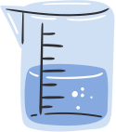




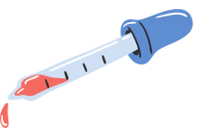

Magnitude of the disease
Is an outbreak of this magnitude unprecedented in modern history?
Notes:
First of all we are going to understand what’s the magnitude of this disease by comparing the COVID-19 with every other epidemic of this century.

Slide 3
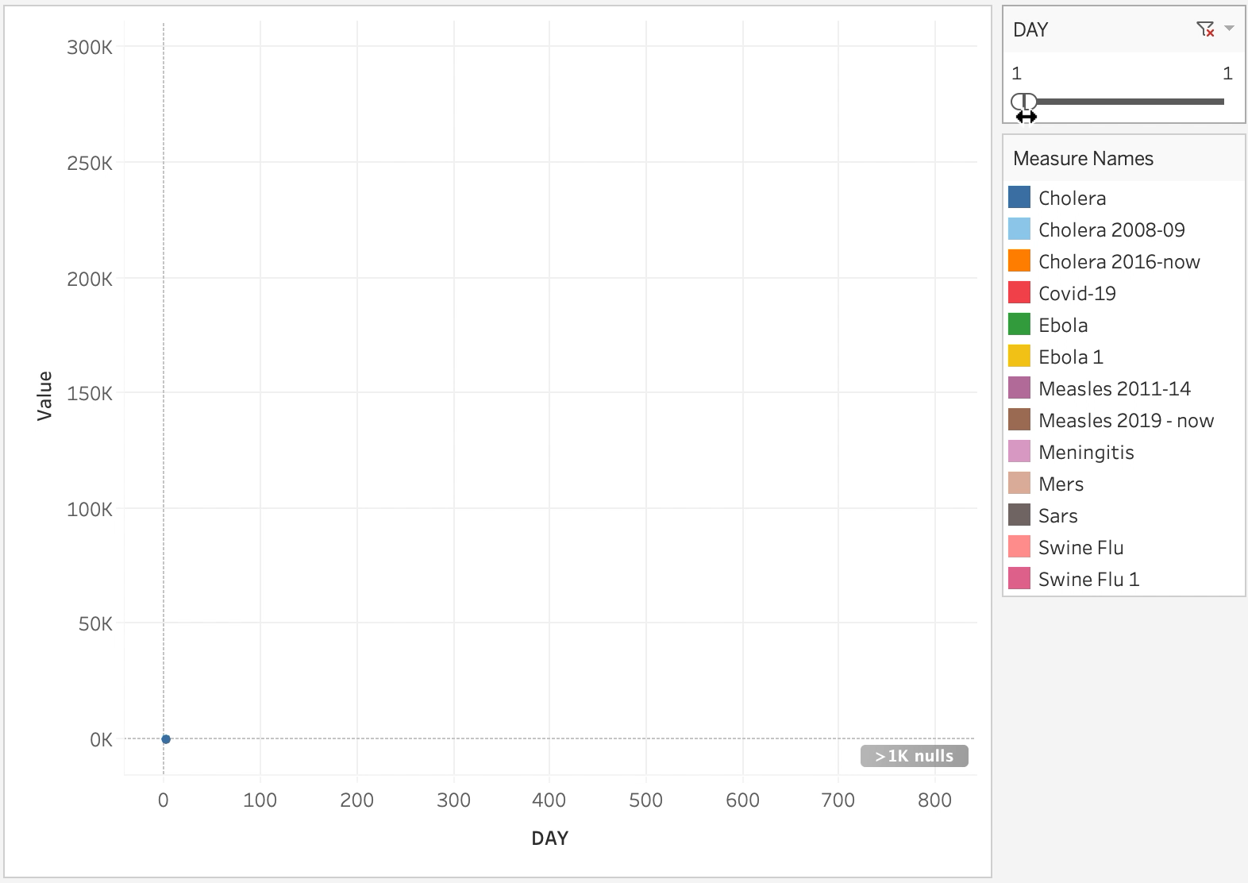
Since 2000, there have been 12 outbreaks with over 500 deaths. (13 counting SARS).
Notes:
Since 2000, there have been 12 outbreaks with over 500 deaths. (13 if you count SARS).
In this graph, we can see the number of deaths per day for each epidemic.
In order to make things fair, I shifted each epidemic’s graph to alighn on Day 1 of the outbreak.
--This is COVID and this one is swine flu.--

Slide 4

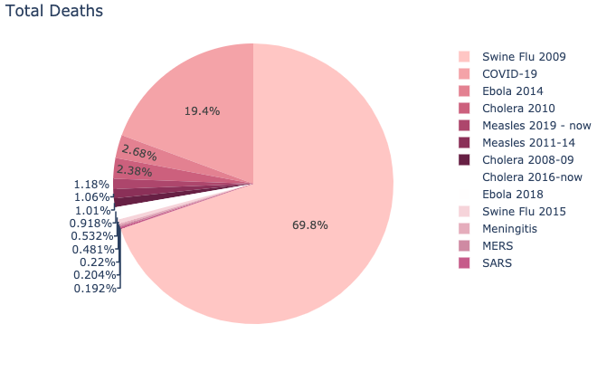
Lately people have been trying to minimize COVID-19 by comparing it to the Swine flu
Although it’s true that so far, Swine Flue has killed 4x more people.
Percentage of total Deaths globally
Notes:
Lately people have been trying to minimize COVID-19 by comparing it to the Swine flu
Although it’s true that so far, Swine Flue has killed 4x more people.

Slide 5
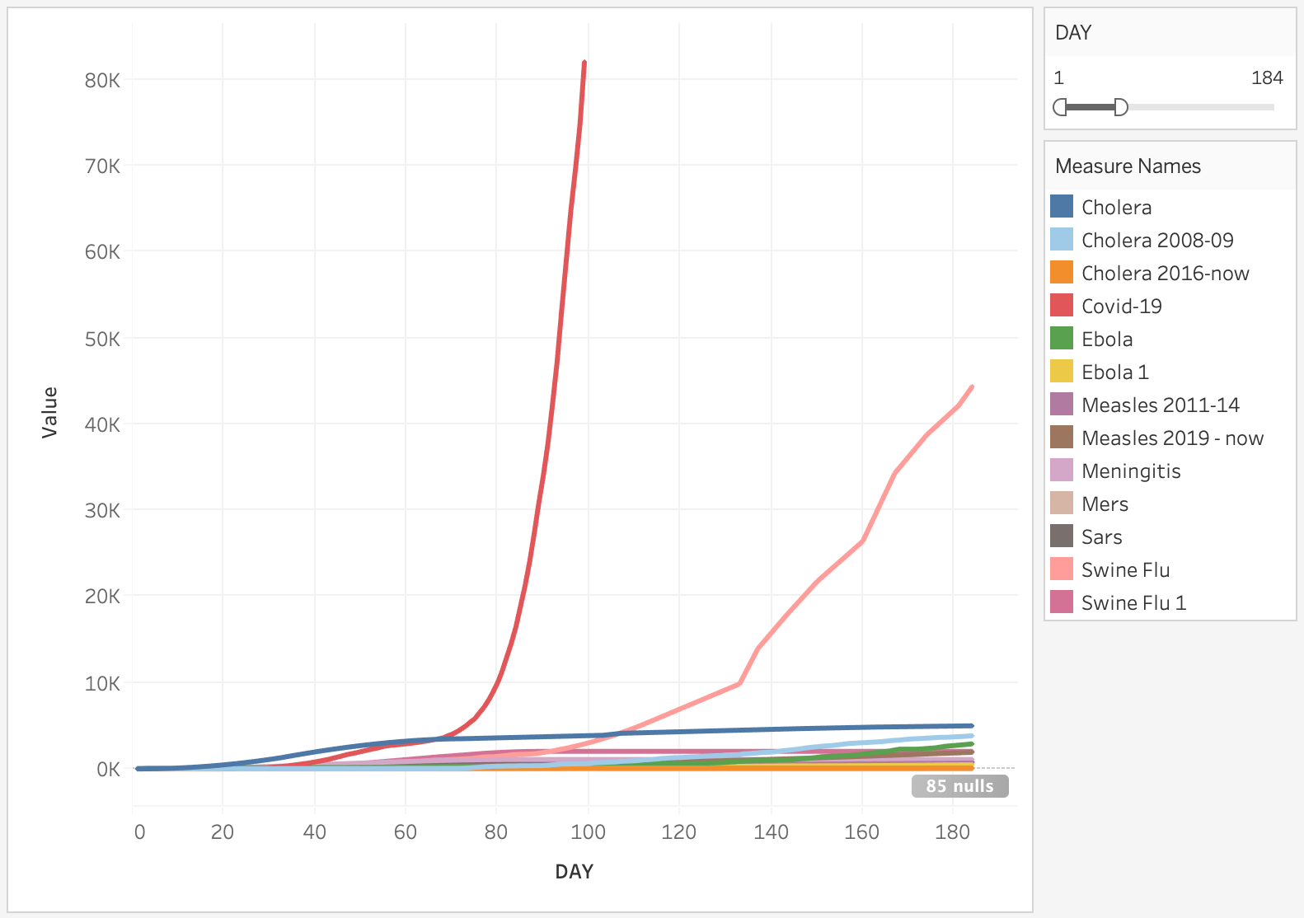
COVID-19 is the fastest-killing outbreak of the century, reaching 10K deaths 3 times faster
Notes:
If we zoom in on the graph the first graph that we saw. Next slide

Slide 6
COVID-19 is the fastest-killing outbreak of the century, reaching 10K deaths 3 times faster
Notes:
We can see that COVID-19 is the fastest-killing outbreak of the century, reaching 10 thousand deaths 3 times faster

Slide 7
COVID-19 Global Spread
What was the evolution of the COVID-19 spread?
Notes:
Let’s see the evolution of COVID-19 spread.

Slide 8
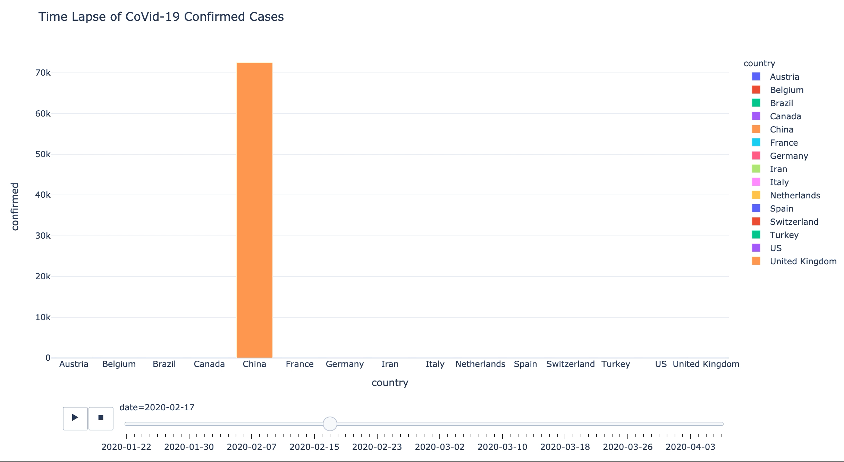
Although, China once had over 99% of the world’s active cases.
As of today,
US, Spain, Italy and other 2 countries have overtaken China in active cases.
Notes:
This graphs shows the confirmed cases per country by date. So we see how this data has been changing throghout the time.
Although China once had over 99% of the world’s active cases, as we can see in the graph. 7/8 of these cases have recovered.
Now we can start to see how the COV in the other countries start to emerge.
As of today, US, Spain, Italy and other 2 countries have overtaken China in active cases. (France and Germany)

Slide 9
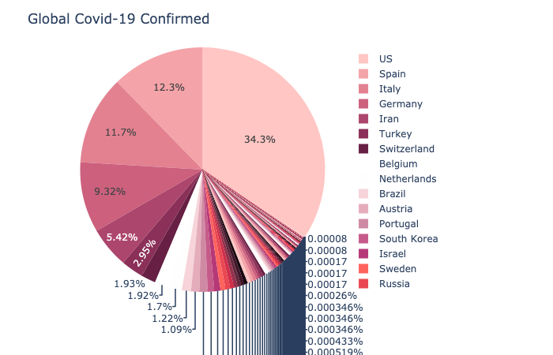
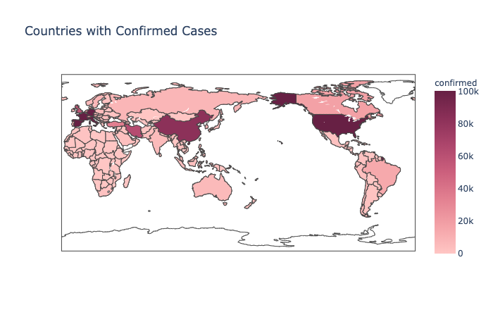
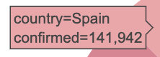
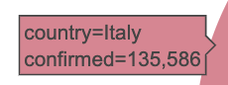
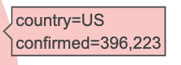
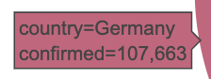
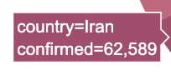
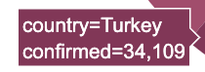
US is right now the country with more confirmed cases. 396,223 specifically, supposing 34.3% of the total cases.
Notes:
Us is right now the country with more confirmed cases. With the 34% out of the global confirmed cases.

Slide 10
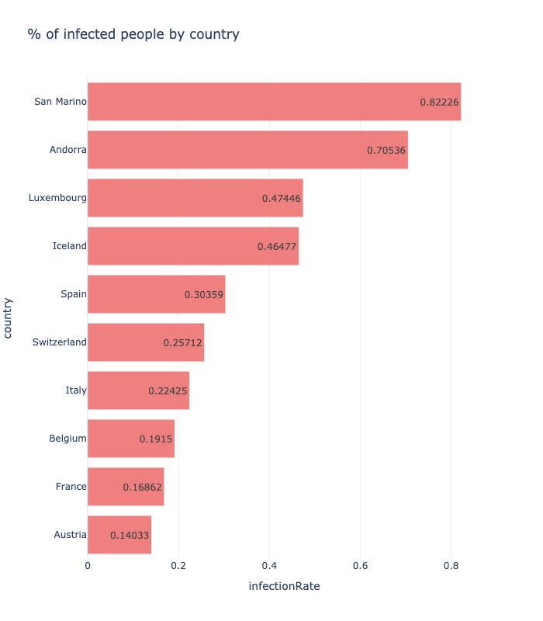
Considering the population, San Marino is the country with the highest percentage of cases / population.
Notes:
But when we talk about U.S in this case, it’s true that there are a lot of cases, but also, there is a lot more population than Spain, for example.
If we take into account the population, San Marino is the country with the highest percentage of cases / population, followed by Andorra and Luxembourg.

Slide 11
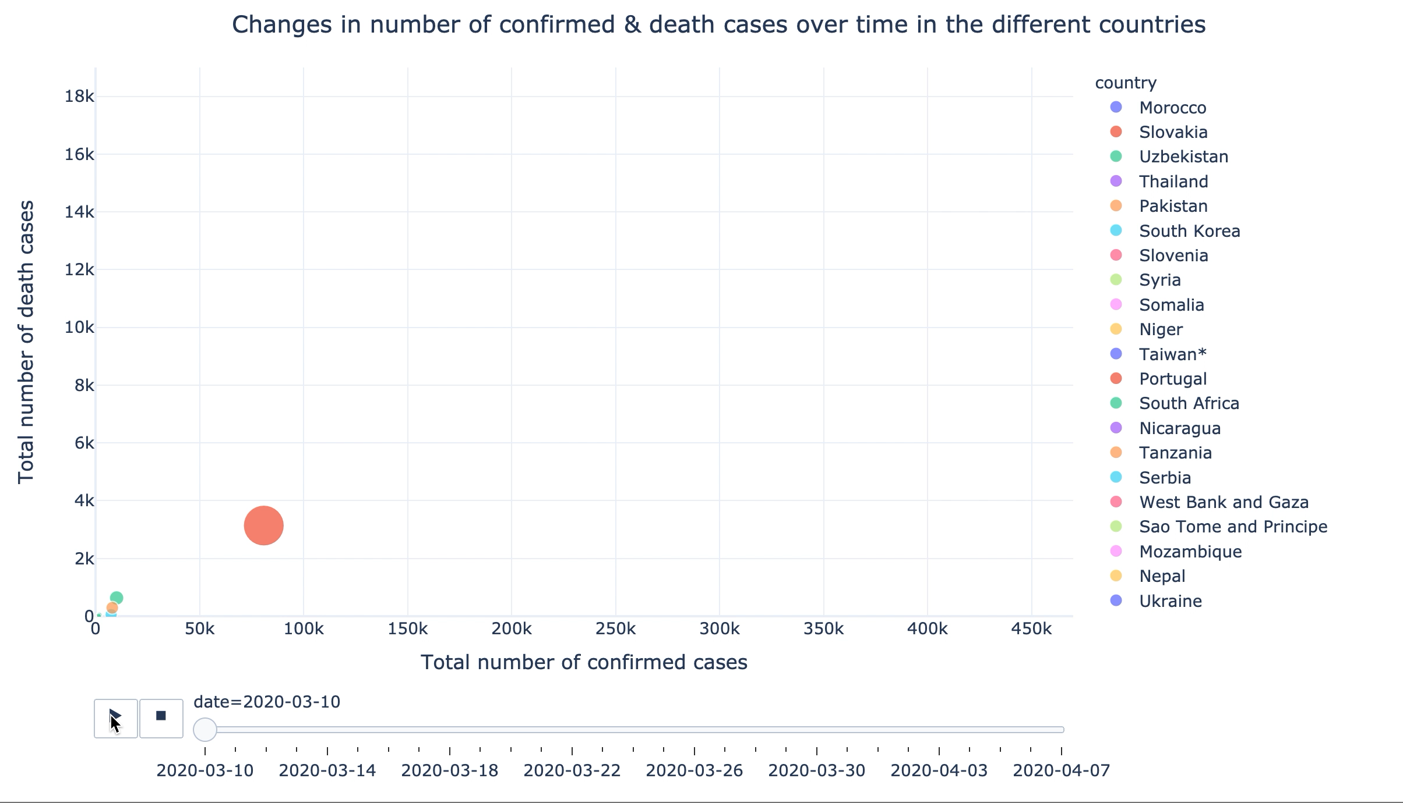
As per today, US may be leading the confirmed cases.
But Italy, followed by Spain are the countries with a greater number of deaths.
Notes:
This graphs shows the confirmed cases per country by date, as the last one that we saw. But it also takes into account the deaths cases.
As per today, US may be leading the confirmed cases.
But it is Italy, followed by Spain are the countries with a greater number of deaths.

Slide 12
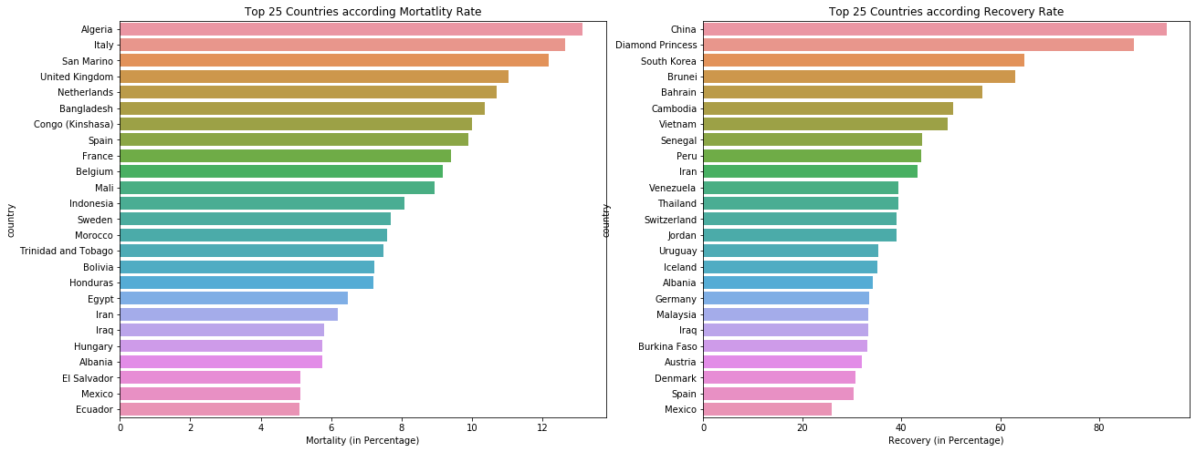
Even if Italy has the highest number of deaths, it’s Algeria the one having the highest Mortality Rate.
94% of the cases in China have recovered, being the country with the highest recovery rate.
Notes:
We also talk about deaths and number of recoveries but without taking into account out of how many cases.
Even if Italy has the highest number of deaths. It's Algeria the one having the highest mortality rate.
94% of the cases in China have recovered, being the country with theh ighest recovery rate. Followed by Diamond princes, the cruiseship that became a coronavirus breeding ground.

Slide 13
European Spread
What was the evolution of the COVID-19 spread in Europe?
Notes:
What is the evolution specifically for Europe?

Slide 14
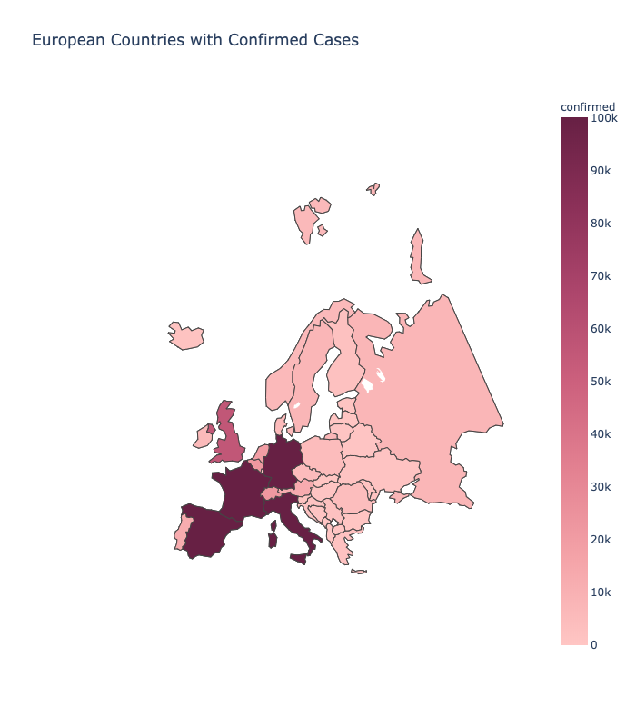
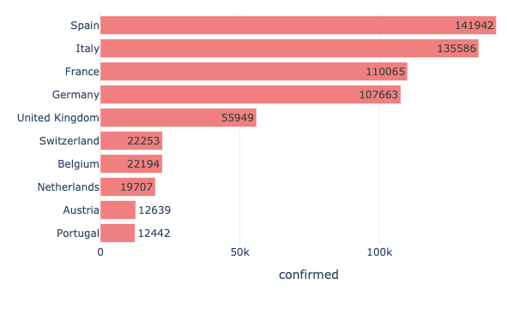
If we zoom in Europe, we see that Spain is the country with highest confirmed cases, followed by Italy.
Notes:
If we zoom in Europe, we see that Spain is the country with the highest confirmed cases, followed by Italy.
So congratulations to us…

Slide 15
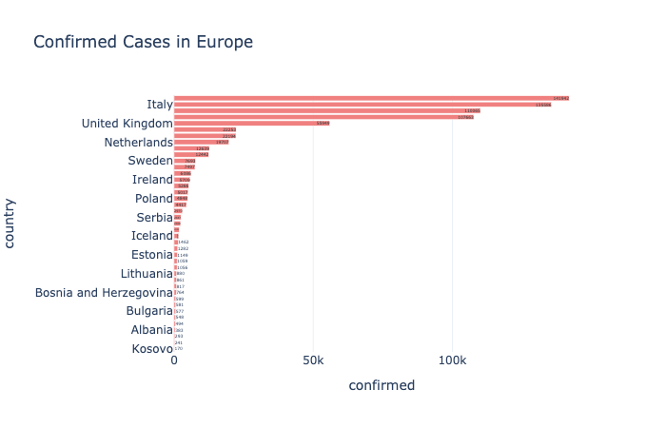
Kosovo is the country with least cases in Europe, 137 specifically.
Notes:
And if we want to know what's the country with least cases, that's Kosovo.

Slide 16
Effect of Temperature
Is there any correlation between weather metrics and the spread of the number of infections/deaths?
Notes:
Now it comes the juicy part of the project!
Now we are going to see if there's any correlation between weather metrics and the spread of the disease.

Slide 17
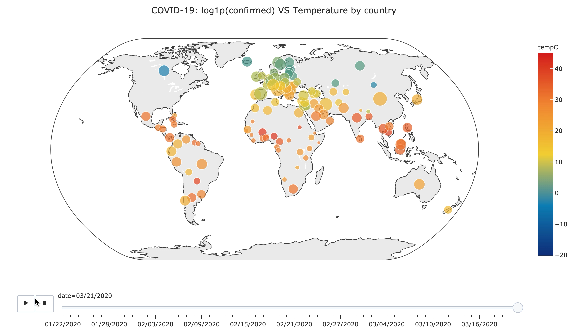
Notes:
The colour of the bubbles represents the temperature. Being red the highest and blue the lowest.
The size of the bubble represents the number of cases of COVID-19.
And we can see how it evolves throughout the time

Slide 18
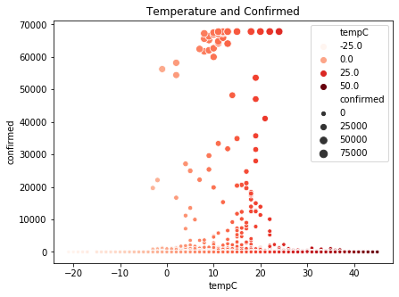
Although the spread of COVID-19 is across all the temperature range,
The temperature range -4 /17ºC has the highest number of confirmed case count.
Notes:
Although the spread of COVID-19 is across all the temperature range,
The temperature range from -4 to 17 celcious degrees has the highest number of confirmed case count.
----
But of course, there are a lot of external variables that may have affected the spread. Like closing the fronteres etc.

Slide 19
Predictions
Prediction of the COVID-19 trend using a mathematical epidemic model
Notes:
What are my predictions on the COVID-19 trend?

Slide 20
Used SEIR model:
Parameters used in the model:
R_t : reproduction number at time t. Typical 3.6 at t=0
T_inc : average incubation period. Typical 5.2 days
T_inf : average infectious period. Typical 2.9 days.
Cfr : case fatality rate
Susceptible
Exposed
Infected
Recovered/ Deceased
Notes:
For the predictions I used a mathematical epidemic model called SEIR.
The abbreviations refer to the population groups involved in a epidemic: Susceptible, Exposed, Infected, Recovered & Deceased.
I also included 4 parameters in the differential equations:
- the average number of infections caused by an infected person.
- the average incubation period.
- the average infectious period
- the case fatality rate
-----
"Ideally, it should be below 1 because this way, the epidemic will disappear by itself," says the mathematics.
Exposed: Those people who incubate the virus without showing symptoms.

Slide 21
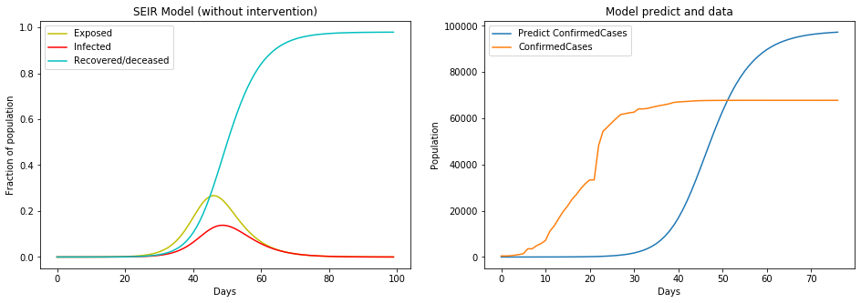
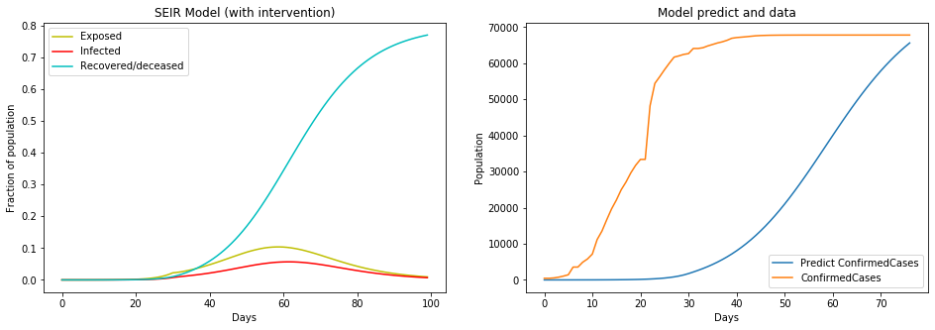
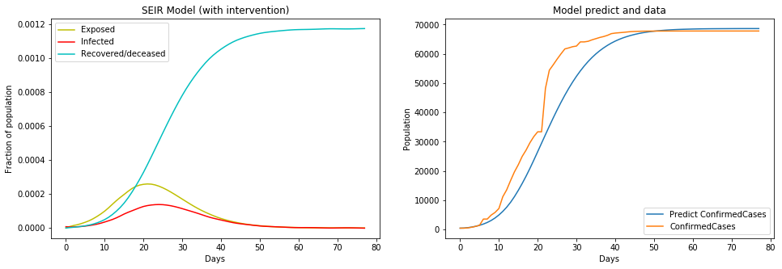
Model without intervention
Notes:
This is the model without intervention. An example of intervention is the quarantine.

Slide 22
Model with intervention
Notes:
This is the model with intervention.

Slide 23
We can see the impact of the intervention, with the reduction on the rate at which new cases occur.
Notes:
We can see the impact of the intervention with the reduction of the rate at which new cases occur. Distributing then, the infected people throghout the time. Which makes it easy for the society to cope with the situation, taking into account that our resources are limited.

Slide 24
The predictions with the intervention are more accurate
Notes:
The predictions with the intervention are more accurate.

Slide 25
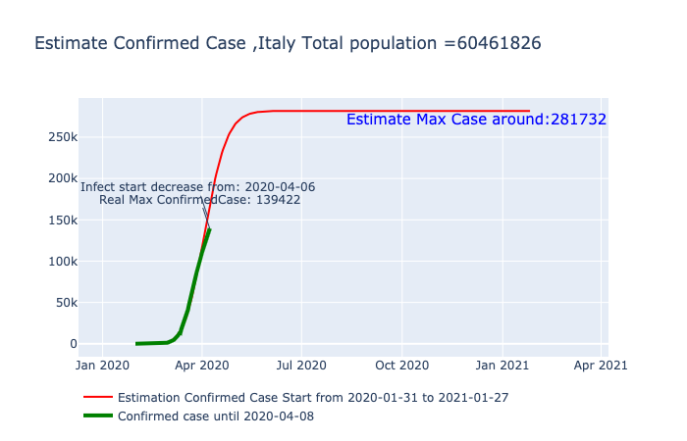
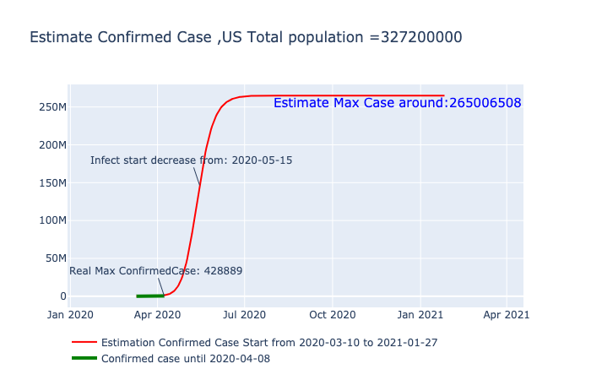
Italy has already arrived at its inflection point but the US still has a long way
Notes:
I used my model for both Italy and US.
The green line represents the real data. The red one is the estimation.
Since we use the real data (the green line), in order to get the predictions, and we have more data in Italy, since the COVID-19 started there earlier, that means that the prediction may be more accurate than the one for the US. But both predictions are until January 2021.
Anyways, the conclusions here are that Italy has already arrived at its inflection point, meaning that the trend starts to decrease.
But the US still has a long way.
https://www.agenciasinc.es/Reportajes/Un-modelo-un-teorema-y-teoria-de-juegos-contra-el-coronavirus

Slide 26
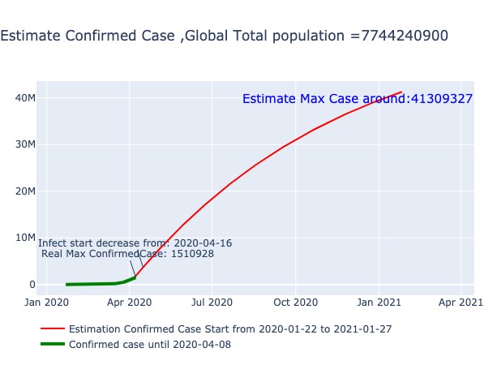
Globally we are almost arriving to the inflection point, it looks like the growth rate will start decreasing on the 16th of April.
Notes:
Good news here, Globaly we are almost arriving to the inflection point already, it looks like the growth rate is decreasing.

Slide 27
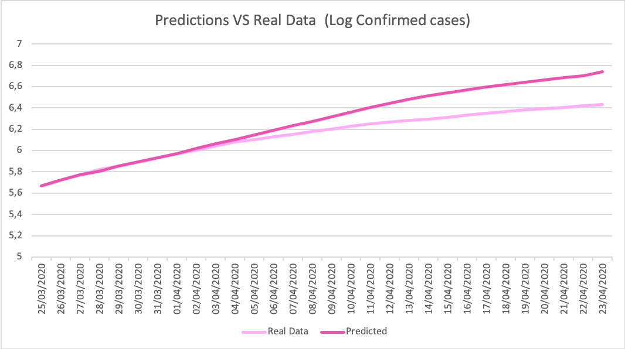
Checking the accuracy of our prediction
1,90 VS 1,30
Notes:
Since my predictions where done weeks ago, wanted to take advantage of it, and compare it with what actually happened.
if we compare the predicted results with the real ones we can see that there are some differences between them although there is a similar pattern between both cases.
When looking at the growth ratio, I said that the growth rate will start decreasing on the 16th of April, and if we look at the point of inflection, we see that it’s 1,90 vs 1,30. Meaning that we got a good accuracy on terms of the trend.
As in any model, future improvements and optimization are required so this would be a future development/ future step

Slide 28
Impact on Economy
How the COVID-19 is affecting the global stock markets?
Notes:
We are all hearing at the news, and starting to worry on how this will impact our economy.
Let's quantify it in real data.

Slide 29
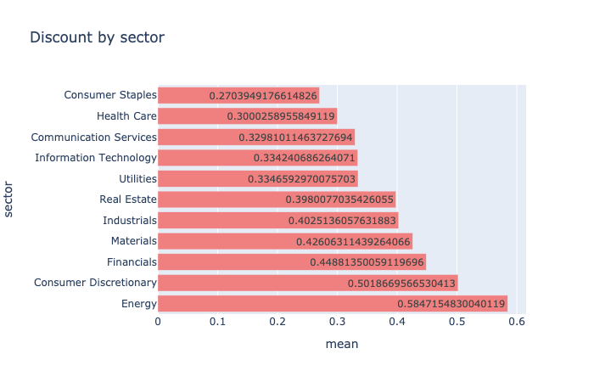
The Energy sector on average has the highest discounted stocks of about 59% .
Whereas Health Care and Consumer Staples have only gone down 28% in comparison
* The consumer staples sector, includes companies that produce items such as food, beverages and non-durable household and personal products.
Notes:
For this analysis, I used the discount that each sector suffered on average after COVID-19 breakdown.
As we can see, the most affected sector is Energy, with the highest discounted sctocks of 59%.
Whereas Health care and consumer staples have only gone down by 28%.
The consumer staples sector, includes companies that produce items such as food, beverages and non-durable household and personal products.
Possible questions:
Consumer discretionary is the term given to goods and services that are considered non-essential by consumers, but desirable if their available income is sufficient to purchase them. Consumer discretionary goods include durable goods, apparel, entertainment and leisure, and automobiles.
The utilities sector refers to a category of companies that provide basic amenities, such as water, sewage services, electricity, dams, and natural gas.
Why energy?
The energy sector is a category of stocks that relate to producing or supplying energy. The energy sector or industry includes companies involved in the exploration and development of oil or gas reserves, oil and gas drilling, and refining.
The company that I took was NBL, a oil & gas company.
The people is staying at home, they don’t need oil, producers are running out on places to put it. Storage costs have gone up so much that prices actually have gone negative. It’s amazing!
This I knew it before it went negative.

Slide 30
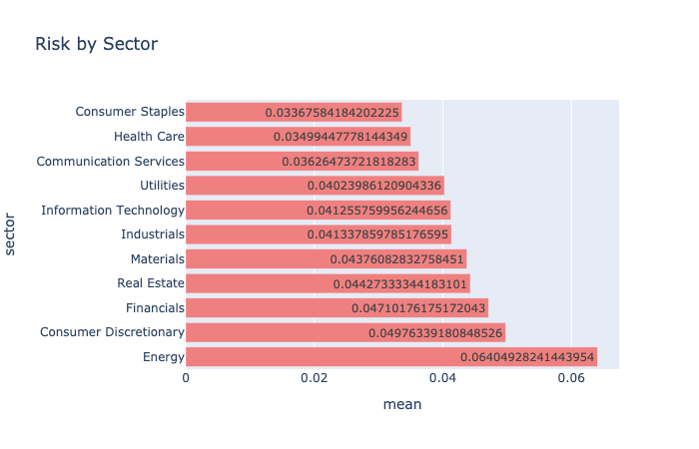
At-risk industries such as Energy (6%) and Consumer Discretionary (5%) have high volatility.
Whereas in Consumer Staples and HealthCare is lower (3%).
Notes:
Similar to the trend in discounts, it can be seen that at-risk industries such as Energy and Consumer Discretionary have higher volatility whereas the volatility in Consumer Staples and Health Care is lower.
The Energy sector on average has a variation of 6.38% and Consumer Staples, on the other hand, has an average variation of 3.36%
The consumer staples sector, includes companies that produce items such as food, beverages and non-durable household and personal products
Possible questions:
Consumer discretionary is the term given to goods and services that are considered non-essential by consumers, but desirable if their available income is sufficient to purchase them. Consumer discretionary goods include durable goods, apparel, entertainment and leisure, and automobiles.
The utilities sector refers to a category of companies that provide basic amenities, such as water, sewage services, electricity, dams, and natural gas.
Why energy?
The energy sector is a category of stocks that relate to producing or supplying energy. The energy sector or industry includes companies involved in the exploration and development of oil or gas reserves, oil and gas drilling, and refining.

Slide 31
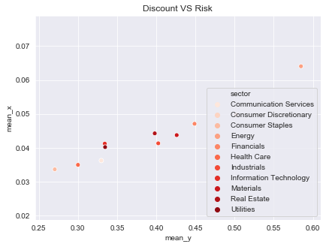
There is a high correlation between discounts and risk.
The sectors at a massive discount (Energy) is also having a higher risk
Notes:
There is a high correlation between discounts and risk.
Possible questions:
Consumer discretionary is the term given to goods and services that are considered non-essential by consumers, but desirable if their available income is sufficient to purchase them. Consumer discretionary goods include durable goods, apparel, entertainment and leisure, and automobiles.
The utilities sector refers to a category of companies that provide basic amenities, such as water, sewage services, electricity, dams, and natural gas.
The energy sector is a category of stocks that relate to producing or supplying energy. The energy sector or industry includes companies involved in the exploration and development of oil or gas reserves, oil and gas drilling, and refining.

Slide 32
There is a high correlation between discounts and risk.
The sectors at a massive discount (Energy) is also having a higher risk
Notes:
The sectors at a massive discount (i.e. Energy) is also having a higher risk.
The objective of this analysis is to look at these highly discounted stocks and pick the ones with lower risk.
Possible questions:
Consumer discretionary is the term given to goods and services that are considered non-essential by consumers, but desirable if their available income is sufficient to purchase them. Consumer discretionary goods include durable goods, apparel, entertainment and leisure, and automobiles.
The utilities sector refers to a category of companies that provide basic amenities, such as water, sewage services, electricity, dams, and natural gas.
The energy sector is a category of stocks that relate to producing or supplying energy. The energy sector or industry includes companies involved in the exploration and development of oil or gas reserves, oil and gas drilling, and refining.

Slide 33
Took the top 1 company with the higher discount within the top 5 discounted sectors
* The consumer staples sector, includes companies that produce items such as food, beverages and non-durable household and personal products.
Notes:
In this case in order to see the most affected ones. I took the top 1 company with higher discount within the top 5 discounted sectors.
Possible questions:
Consumer discretionary is the term given to goods and services that are considered non-essential by consumers, but desirable if their available income is sufficient to purchase them. Consumer discretionary goods include durable goods, apparel, entertainment and leisure, and automobiles.
The utilities sector refers to a category of companies that provide basic amenities, such as water, sewage services, electricity, dams, and natural gas.
The energy sector is a category of stocks that relate to producing or supplying energy. The energy sector or industry includes companies involved in the exploration and development of oil or gas reserves, oil and gas drilling, and refining.

Slide 34
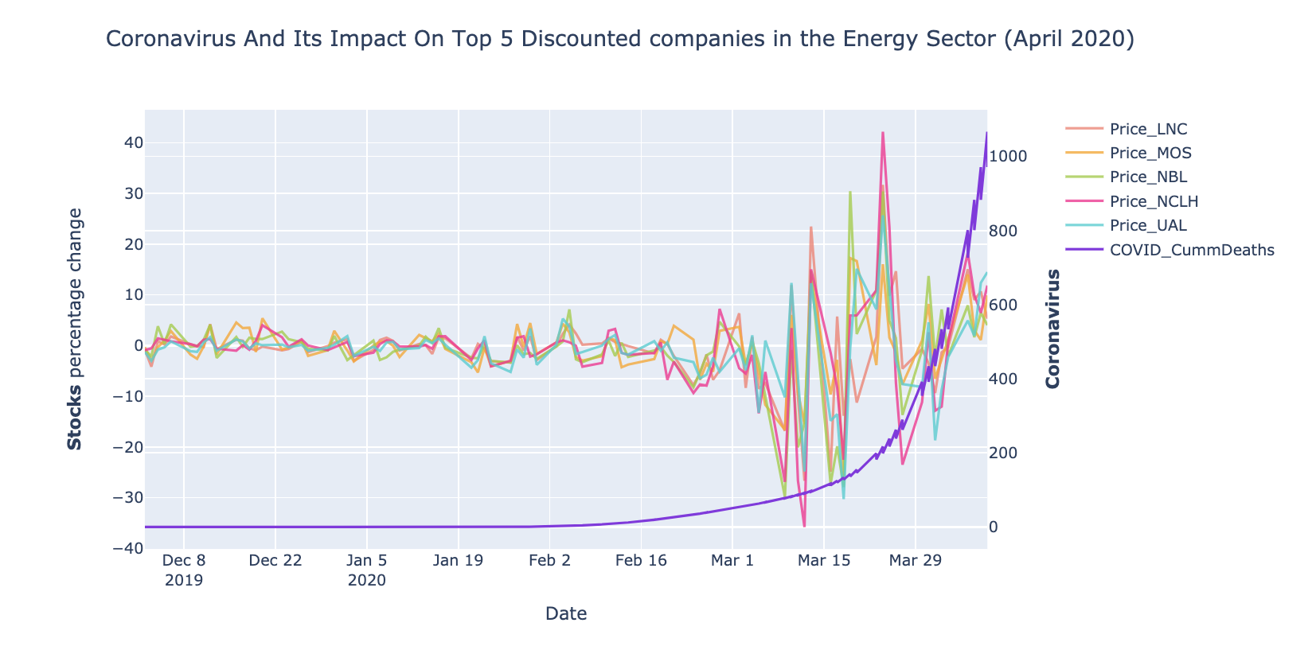
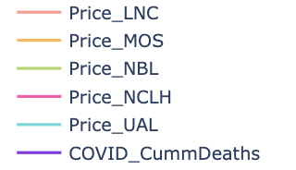
It is not surprising that March 2020 has the greatest number of drops.
Half of the companies experienced their lowest return on 16th March.
Notes:
From those 5 companies, took daily stock percentage change on prices from the 1st of December, 2019 to current date. There wasn’t any specific reason to choose the specified date, the idea was to capture enough historical data to understand what was happening before the crash.
The purple line is the COVID-19 and we see that at the beginning the percentage change was more or less stable and when COV starts to emerge, It is not surprising that March 2020 has the most number of drops. Companies experiences their lowest return.
Possible questions:
LNC: Financials
MOS: Materials
NBL: Energy
NCLH : Consumer Discretionary
UAL: Industrials
Consumer discretionary is the term given to goods and services that are considered non-essential by consumers, but desirable if their available income is sufficient to purchase them. Consumer discretionary goods include durable goods, apparel, entertainment and leisure, and automobiles.
The utilities sector refers to a category of companies that provide basic amenities, such as water, sewage services, electricity, dams, and natural gas.
The energy sector is a category of stocks that relate to producing or supplying energy. The energy sector or industry includes companies involved in the exploration and development of oil or gas reserves, oil and gas drilling, and refining.

Slide 35
Conclusions:
COVID-19 is the fastest-killing outbreak of the century, reaching 10K deaths 3 times faster.
The temperature range -4/17ºC has the highest number of confirmed case count.
The stock market is unstable, experiencing the lowest returns.
My predictions where pretty accurate but as in any model, future improvements and optimization are required

Slide 36
Annex
Notes:
We are all hearing at the news, and starting to worry on how this will impact our economy.
Let's quantify it in real data.

Slide 37
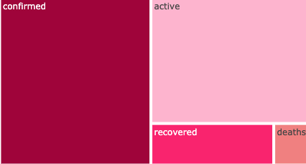
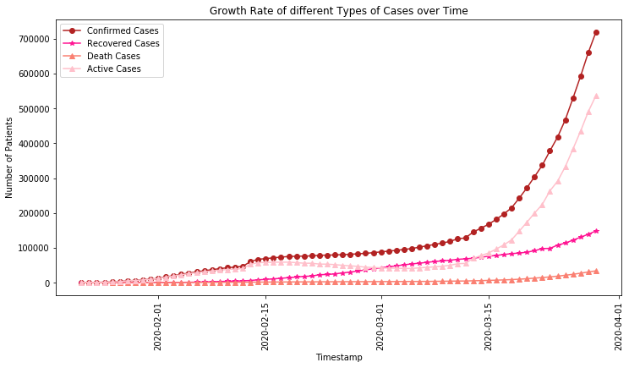
From the total confirmed cases, the 20% recovered and the 6% died, leaving 74% still active.
At the current rate, there are signs of a drop in the trend of total cases.
Notes:
From the total confirmed cases, the 20% recovered and the 6% diead, leaving 74% still active.
In this graph we can see the growth rate of the different types of cases over time.
At the current rate, there are signs of a drop in the trend of total cases.

Slide 38
Age & Gender
Is there any correlation between age and gender with COVID-19 deceases?
Notes:
Now we are going to check if there's any trend as of Age and Gender.

Slide 39
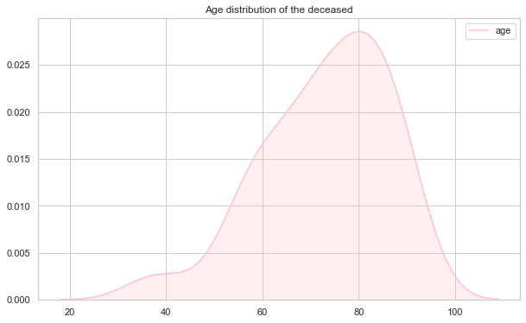
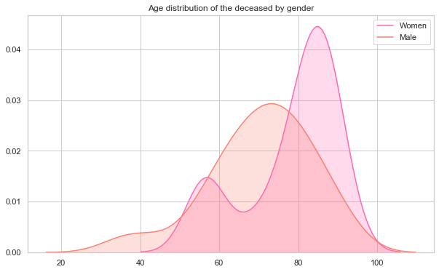
Cases in COVID-19 are happening in all the age groups. But the age group of 70 to 90 have a higher mortality rate.
Men are more likely to die from coronavirus than women.
Female deaths tend to be on elder ages.
Notes:
Cases in COVID are happening in all the age groups. But the age group of 70 to 90 have a higher mortality rate.
Men are more likely to die from coronavirus than women.
If we look at both gender and age together. We see that for men it follows a normal distribution. On the other hand, women are concentrated in a higher range of age.

Slide 40
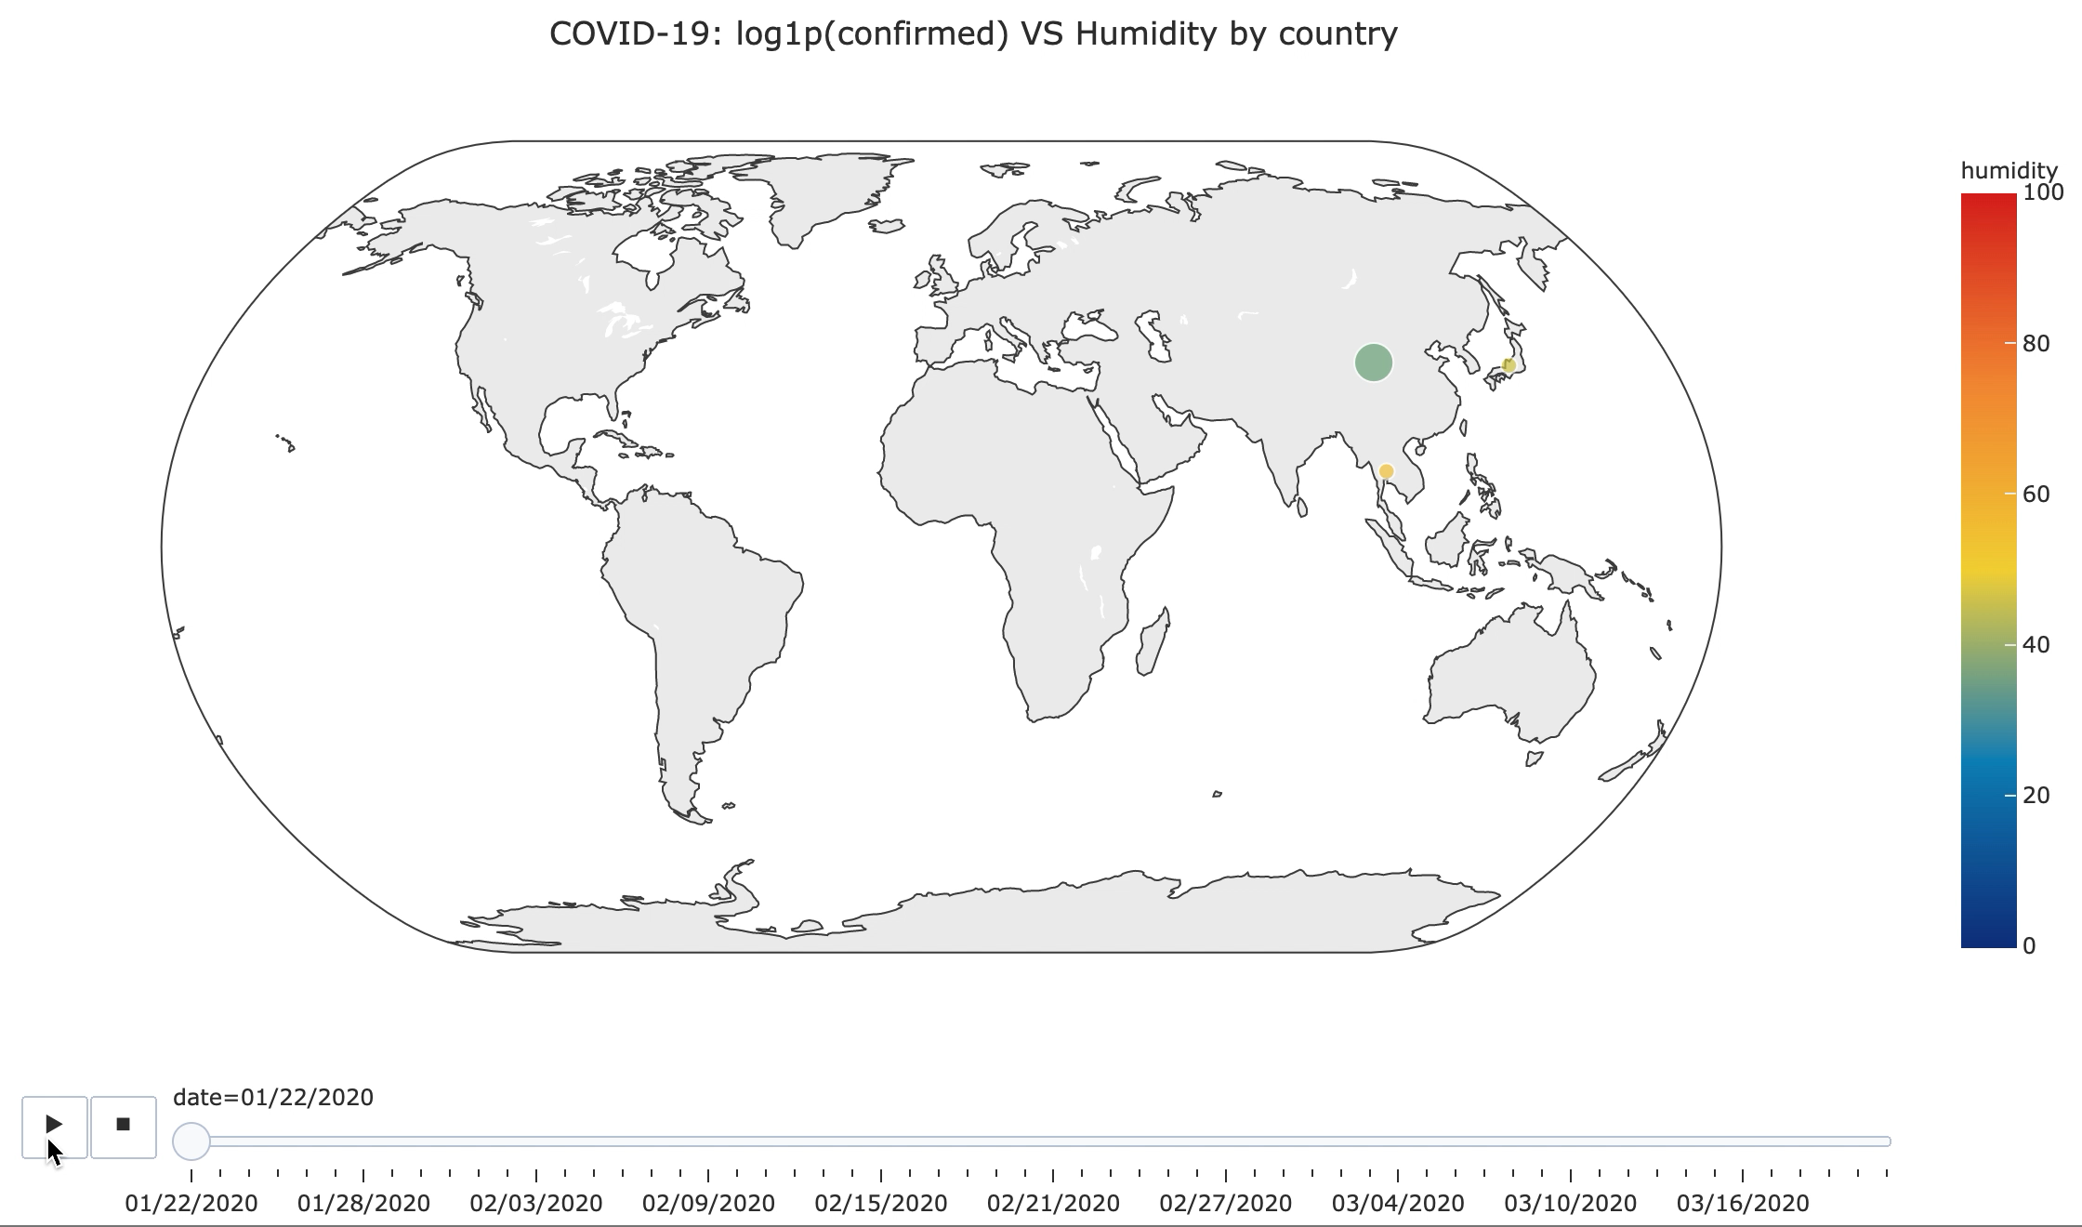
Notes:
This is the same analysis that we did previously on temperature, but this time using humidity as the target variable.
And although we saw that with temperature, there was a clear correlation, in the next slide we are going to prove that there's no correlation in the case of humidity.

Slide 41
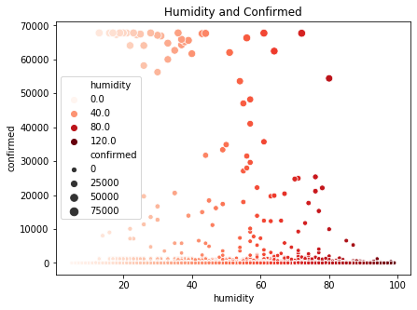
There’s no correlation between humidity and COVID-19 spread.
Notes:
This graphs show us evidence that there's no correlation among this two variables. Because all the data is dispersed accross the graph, with any clear relation.

